Slide 1
Operators and expressions
An operator is a special symbol that tells the compiler to perform certain mathematical or logical operations or manipulations.
Operators are used in program to manipulate data and variables.
An operand is a value on which any operator works
a + b
a and b -> operands
+ -> operator
C Operators are classified into 7 categories of built-in operators

Slide 2
Operators and expressions
An expression is a construct made up of variables, operators, constants and function invocations
x = 9/2 + a-b;
#include <stdio.h>
int main() {
int a = 10;
result = a*20; // expression
printf("result = %d \n",result);
return 0;
}

Slide 3
7 Types of Operators
Arithmetic Operators
Relational Operators
Assignment Operators
Logical Operators
Bitwise Operators
Increment and Decrement Operators
Special Operators

Slide 4
i) Arithmetic Operators
An arithmetic operator performs mathematical operations such as addition, subtraction and multiplication on numerical values (constants and variables).
Operators | Meaning | Example a = 10, b = 5
+ | Add | a + b = 15
- | Sub | a – b = 5
* | Multiplication | a * b = 50
/ | Division | a / b = 2
% | Modulos | a % b = 0
Notes:
Title + Image + Text

Slide 5
If you have more than one arithmetic operator in an expression, which operator will execute first?
B O D M A S
%
*
+
-
order
Brackets ()

Slide 6
What is the difference between % and / operator?
/ -> Quotient
% -> Remainder

Slide 7
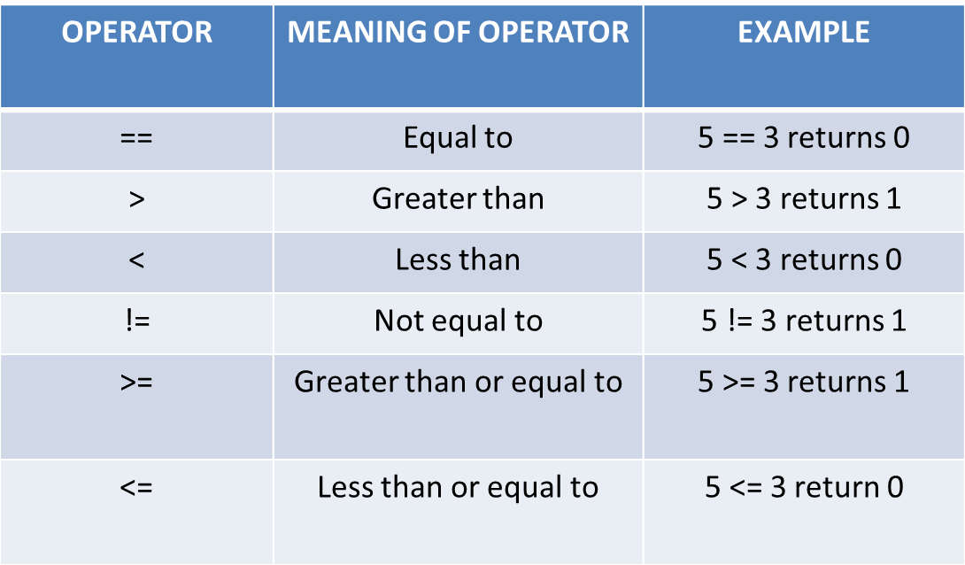
ii) Relational Operators
A relational operator checks the relationship between two operands It is used to form a condition
If the relation is true, it returns 1; if the relation is false, it returns value 0. These are used in decision making .
Notes:
Title + Image + Text

Slide 8
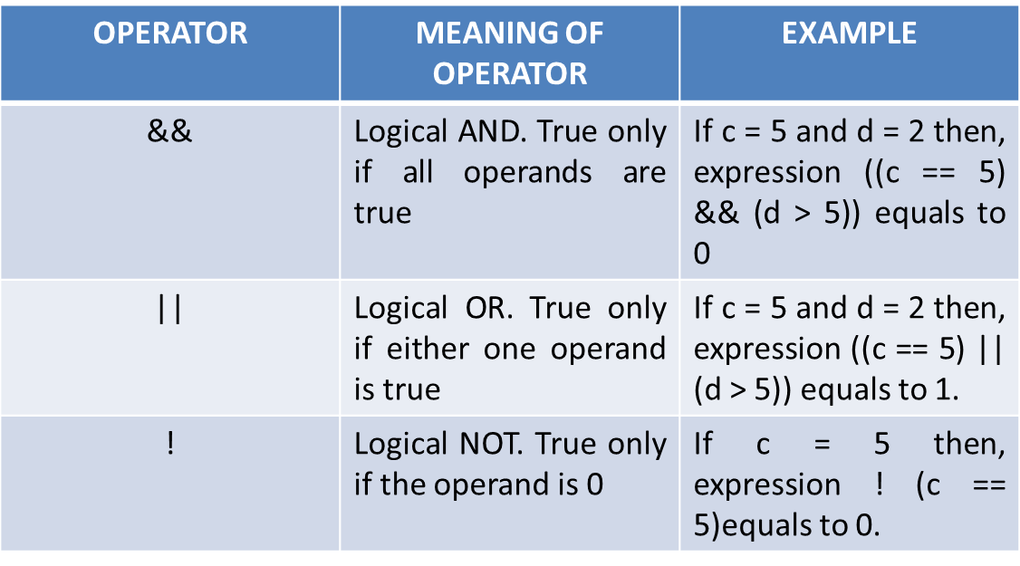
iii) Logical Operators
It is used to combine the conditions when you have more than one
An expression containing logical operator returns either 0 or 1 depending upon whether expression results true or false
Notes:
Title + Image + Text

Slide 9
iii) Assignment Operators
Right side value will be assigned to the left side variable
Operator | Example | Meaning
= | a = b | a = b
+= | a += b | a = a+b
-= | a -= b | a = a-b
*= | a *= b | a = a*b
/= | a /= b | a = a/b
%= | a %= b | a = a%b
Notes:
Title + Image + Text

Slide 10
iv) Bitwise Operators
Perform manipulations of data at the bit level. These operators also perform the shifting of bits from right to left.
Operator | Description | Example
& | Bitwise AND | Performs a bitwise AND operation
| | Bitwise OR | Performs a bitwise OR operation
~ | One's complement (NOT) | bitwise NOT operator "~" inverts a bit pattern; making every "0" as "1" and every "1" as "0"
^ | Bitwise Exclusive OR (XOR) | Performs a bitwise exclusive OR operation.
>> | Shift right | int a = 00010000 ;b = 2; a >> b = 00000100
<< | Shift left | int a = 00010000 ;b = 2; a << b = 01000000;

Slide 11
iv) Bitwise Operators
To perform bit-level operations.
a | b | a & b | a | b | a ^ b
0 | 0 | 0 | 0 | 0
0 | 1 | 0 | 1 | 1
1 | 0 | 0 | 1 | 1
1 | 1 | 1 | 1 | 0
a = 6➔ a=0110
b = 4→ b=0100
a&b=0100
Notes:
Title + Image + Text

Slide 12
// Program
1
2
3
4
5
6
7
8
9
10
11
12
13
14
#include <stdio.h>
x = 1 0 1 1
y = 0 1 1 1
int main() {
x | y = 1 1 1 1
int x = 11;
int y = 7;
int a = 8;
int b = 1;
printf(“%d”, x | y);
printf(“%d”, x & y);
printf(“%d”, x ^ y);
printf(“%d”, a << b);
printf(“%d”, a >> b);
return 0;
}

Slide 13
// Program
1
2
3
4
5
6
7
8
9
10
11
12
13
14
#include <stdio.h>
x = 1 0 1 1
y = 0 1 1 1
int main() {
x & y = 0 0 1 1
int x = 11;
int y = 7;
int a = 8;
int b = 1;
printf(“%d”, x | y);
printf(“%d”, x & y);
printf(“%d”, x ^ y);
printf(“%d”, a << b);
printf(“%d”, a >> b);
return 0;
}

Slide 14
// Program
1
2
3
4
5
6
7
8
9
10
11
12
13
14
#include <stdio.h>
x = 1 0 1 1
y = 0 1 1 1
int main() {
int x = 11;
x ^ y = 1 1 0 0
int y = 7;
int a = 8;
int b = 1;
printf(“%d”, x | y);
printf(“%d”, x & y);
printf(“%d”, x ^ y);
printf(“%d”, a << b);
printf(“%d”, a >> b);
return 0;
}

Slide 15
// Program
1
2
3
4
5
6
7
8
9
10
11
12
13
14
#include <stdio.h>
Output:
16
int main() {
int x = 11;
int y = 7;
int a = 8;
How?
int b = 1;
printf(“%d”, x | y);
printf(“%d”, x & y);
printf(“%d”, x ^ y);
printf(“%d”, a << b);
printf(“%d”, a >> b);
return 0;
}

Slide 16
// Program
1
2
3
4
5
6
7
8
9
10
11
12
13
14
#include <stdio.h>
Output:
4
int main() {
int x = 11;
int y = 7;
int a = 8;
How?
int b = 1;
printf(“%d”, x | y);
printf(“%d”, x & y);
printf(“%d”, x ^ y);
printf(“%d”, a << b);
printf(“%d”, a >> b);
return 0;
}

Slide 17
Left-shift operator
It is an operator that shifts the number of bits to the left-side.
Syntax:
Operand << n
Operand is an integer expression on which we apply the left-shift operation.
n is the number of bits to be shifted.
int a = 5;
The binary representation of 'a' is given below:
a = 0101
If we want to left-shift the above representation by 2, then the statement would be:
a << 2;
0101<<2 = 00010100
Notes:
Title + Image + Text

Slide 18
Right-shift operator
It is an operator that shifts the number of bits to the right-side.
Syntax:
Operand >> n
Operand is an integer expression on which we apply the right-shift operation.
n is the number of bits to be shifted.
int a = 7;
The binary representation of the above variable would be:
a = 0111
If we want to right-shift the above representation by 2, then the statement would be:
a>>2;
0000 0111 >> 2 = 0000 0001
Notes:
Title + Image + Text

Slide 19
Increment and Decrement Operators
These are the unary operators used to increment or decrement the value of an operand or variable by one
++
Increment the value by 1.
--
Decrement the value by 1.
Notes:
Title + Image + Text

Slide 20
What is the difference between ++a and a++?
++a | a++
Pre - increment | Post - increment
First increment by 1 then, it returns the value | First return the original value then, it is incremented by 1.
Ex.
x = ++a;
Similarly, --a and a--

Slide 21
Special Operators
Sizeof()
&
*
Ternary( ? : ) (conditional operator

Slide 22
Ternary Operator or Conditional Operator
Ternary Operator is also known as conditional operator. It works on three operands.
Syntax:
condition ? statement1 : statement2
The question mark ? in the syntax represents the if part.
The condition returns either true or false, based on which it is decided whether Statement1(expression 1) will be executed or (expression 3)
If condition returns true then the expression 1 is executed.
If condition returns false then the expression 2 is executed
E.g: 10 < 20 ? printf(" True ") : printf(" False ");

Slide 23
Special Operators
sizeof() operator will returns the number of memory bytes allocated for the data (constant, variables, array, structure etc).
returns the size(length in bytes) of entity, for eg. a variable or an array, etc.
sizeof(x) will return size of the variable x

Slide 24
// Program
1
2
3
4
5
6
7
8
9
10
11
12
13
14
#include <stdio.h>
int main() {
int a;
float b;
double c;
char d;
printf(“%d bytes”, sizeof(a));
printf(“%d bytes”, sizeof(b));
printf(“%d bytes”, sizeof(c));
printf(“%d byte”, sizeof(d));
return 0;
}

Slide 25
Special operators
Operator | Description | Example
& | returns the memory address of the variable | &x will return address of the variable x
* | The * operator returns the value stored at a memory address. | m = &x (memory address of variable x) *m will return the value stored at memory address m

Slide 26
Special operators
Operator | Description | Example
. (dot) operator | used to access individual elements of a C structure or C union. | If emp is a structure with an element int age in it, then emp.age will return the value of age.
-> (arrow) operator | used to access structure or union elements using a pointer to structure or union. | If p is a pointer to the emp structure, then we can access age element using p->age
[ ] operator | used to access array elements using indexing | if arr is an array, then we can access its values using arr[index], where index represents the array index starting from zero

Slide 27
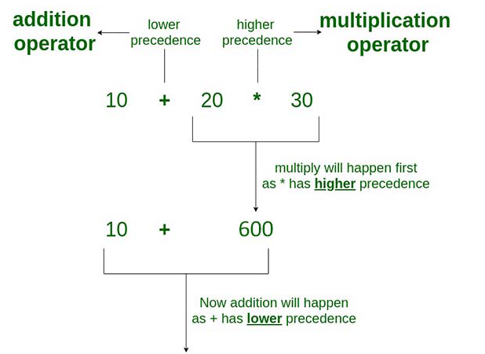
Precedence and associativity of Operators in C
The precedence of operator species that which operator will be evaluated first and next.
int value=10+20*10;
The value variable will contain 210 because * (multiplicative operator) is evaluated before + (additive operator).

Slide 28
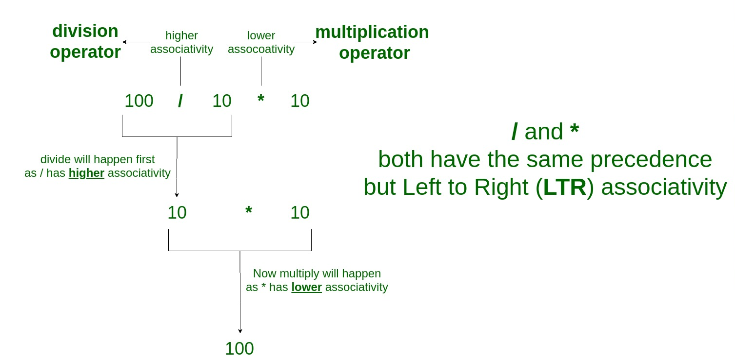
Precedence of Operators in C
The associativity specifies the operator direction to be evaluated; it may be left to right or right to left.
‘*’ and ‘/’ have same precedence and their associativity is Left to Right.
E.g. 100 / 10 * 10

Slide 29
Precedence | Category | Operator | Associativity
1 | Postfix | () [] -> . ++ - - | Left to right
2 | Unary | + - ! ~ ++ - - (type)* & sizeof | Right to left
3 | Multiplicative | * / % | Left to right
4 | Additive | + - | Left to right
5 | Shift | << >> | Left to right
6 | Relational | < <= > >= | Left to right
7 | Equality | == != | Left to right
8 | Bitwise AND | & | Left to right
9 | Bitwise XOR | ^ | Left to right
10 | Bitwise OR | | | Left to right
11 | Logical AND | && | Left to right
12 | Logical OR | || | Left to right
13 | Conditional | ?: | Right to left
14 | Assignment | = += -= *= /= %=>>= <<= &= ^= |= | Right to left
15 | Comma | , | Left to right

